Slide 1
CS Seminar-1 Muhammad Ovais (CS-141051)

Slide 2
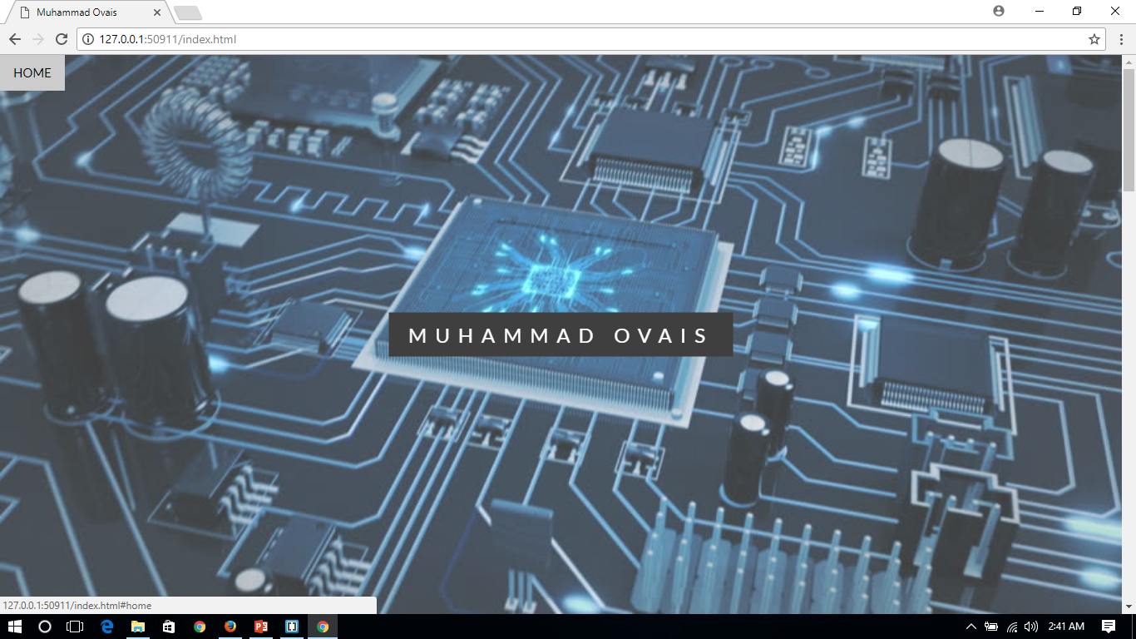

Slide 3
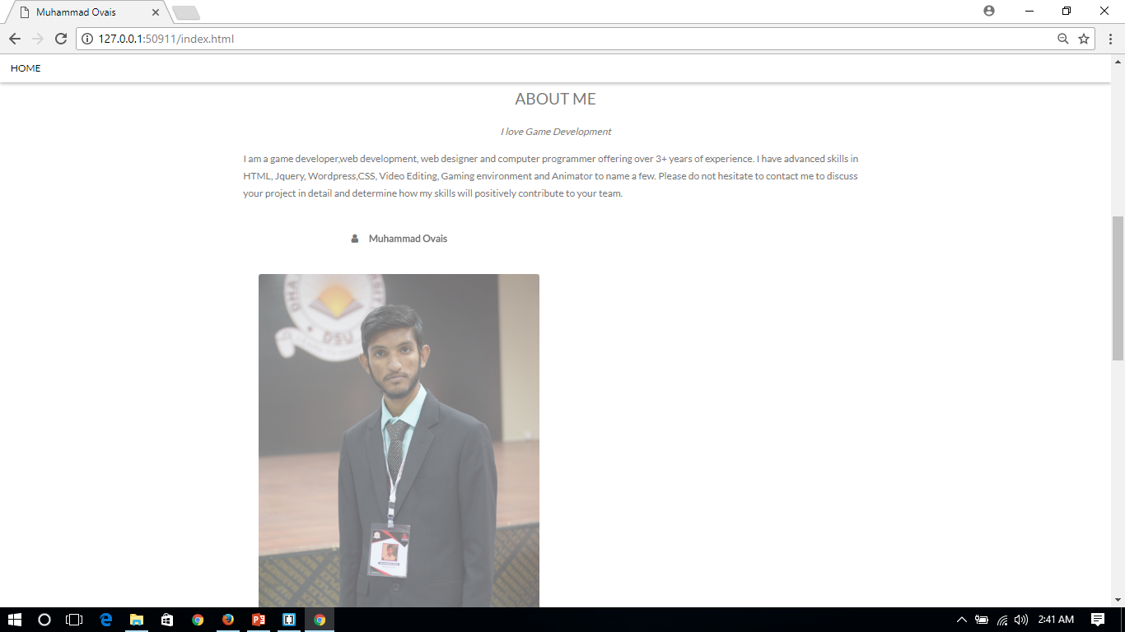

Slide 4
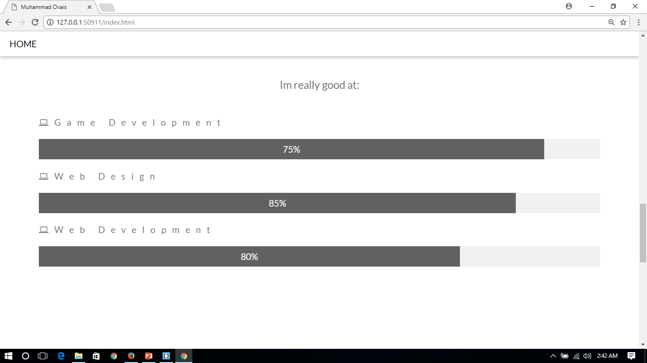

Slide 5
